Slide 1
Brute Force and Exhaustive Search
Group – I Presentation (Solvi Magnusson, Ishan Anand, Rishi Tej Talluri)
Reference : Introduction to Design and Analysis of Algorithms, 3rd Edition by Anany Levitin

Slide 2
1.0 Introduction
Brute force is a straightforward approach to solving a problem, usually
directly based on the problem statement and definitions of the concepts
Involved.
The “force” implied by the strategy’s definition is that of a computer and not that of one’s intellect. “Just do it!” would be another way to describe the prescription of the brute-force approach. And often, the brute-force strategy is indeed the one that is easiest to apply.

Slide 3
2.0 Selection Sort
We start selection sort by scanning the entire given list to find its smallest element and exchange it with the first element, putting the smallest element in its final position in the sorted list.
Then we scan the list, starting with the second element, to find the smallest among the last n − 1 elements and exchange it with the second element, putting the second smallest element in its final position
Generally, on the ith pass through the list, which we number from 0 to n − 2, the algorithm searches for the smallest item among the last n − i elements and swaps it with Ai. After n − 1 passes, the list is sorted.

Slide 4
2.0 Selection Sort Algorithm Contd.
ALGORITHM
//Sorts a given array by selection sort
//Input: An array A[0..n − 1] of orderable elements
//Output: Array A[0..n − 1] sorted in nondecreasing order
for i ←0 to n − 2 do
min←i
for j ←i + 1 to n − 1 do
if A[j ]<A[min] min←j
swap A[i] and A[min]

Slide 5
3.0 Bubble Sort
Another brute-force application to the sorting problem is to compare adjacent elements of the list and exchange them if they are out of order.
By doing it repeatedly, we end up “bubbling up” the largest element to the last position on the list.
The next pass bubbles up the second largest element, and so on, until after n − 1 passes the list is sorted.

Slide 6
3.0 Bubble Sort Contd.
ALGORITHM
//Sorts a given array by bubble sort
//Input: An array A[0..n − 1] of orderable elements
//Output: Array A[0..n − 1] sorted in nondecreasing order
for i ←0 to n − 2 do
for j ←0 to n − 2 − i do
if A[j + 1]<A[j ] swap A[j ] and A[j + 1]

Slide 7
4.0 Sequential Search and Brute-Force String Matching
Here we discuss two applications of this strategy to the problem of searching.
The first deals with the canonical problem of searching for an item of a given value in a given list.
The second is different in that it deals with the string-matching problem.

Slide 8
4.1 Sequential Search
The algorithm simply compares successive elements of a given list with a given search key until either a match is encountered (successful search) or the list is exhausted without finding a match (unsuccessful search).
A simple extra trick is often employed in implementing sequential search: if we append the search key to the end of the list, the search for the key will have to be successful.
Therefore we can eliminate the end of list check altogether.

Slide 9
4.1 Sequential Search Contd.
ALGORITHM
//Implements sequential search with a search key as a sentinel
//Input: An array A of n elements and a search key K
//Output: The index of the first element in A[0..n − 1] whose value is
// equal to K or −1 if no such element is found
A[n]←K
i ←0
while A[i] = K do
i ←i + 1
if i < n return i
else return −1

Slide 10
4.2 Brute-Force String Matching
Given a string of n characters called the text and a string of m characters (m ≤ n) called the pattern, we need to find a substring of the text that matches the pattern.
We want to find i—the index of the leftmost character of the first matching substring in the text—such that
ti = p0, . . . , ti+j = pj, . . . , ti+m−1 = pm−1

Slide 11
4.2 Brute-Force String Matching Contd.
ALGORITHM
//Implements brute-force string matching
//Input: An array T [0..n − 1] of n characters representing a text and
// an array P[0..m − 1] of m characters representing a pattern
//Output: The index of the first character in the text that starts a
// matching substring or −1 if the search is unsuccessful
for i ←0 to n − m do
j ←0
while j <m and P[j ]= T [i + j ] do
j ←j + 1
if j = m return i
return −1

Slide 12
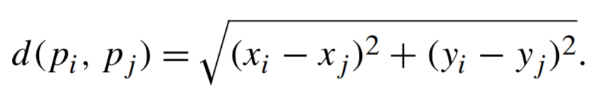
5.0 Closest pair by brute force
The problem of finding the two closest points in a set of n points.
For nonnumerical data, metrics such as Hamming distance is used to solving this problem.
The Euclidean distance metric is usually used for numerical data.
The Euclidean distance, the distance between two numerical points is described as

Slide 13
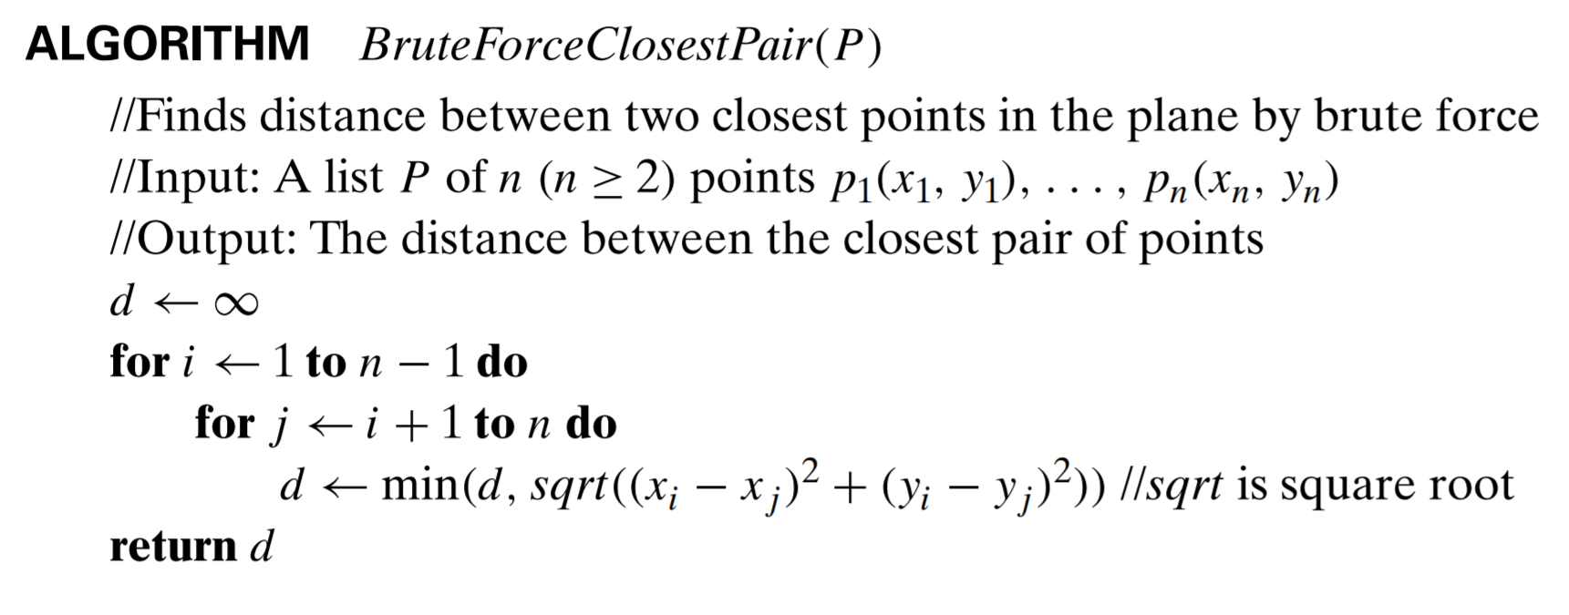
5.0 Closest pair by brute force cont.
Pseudocode for computing the distance between the two closest points out of n points.

Slide 14
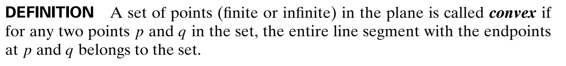
6.0 Convex hull problem
The convex hull problem is the problem of constructing the convex hull for a given set S of n points.
To solve: Find all points that will serve as the vertices of the polygon in question.
Those points are called Extreme points.

Slide 15
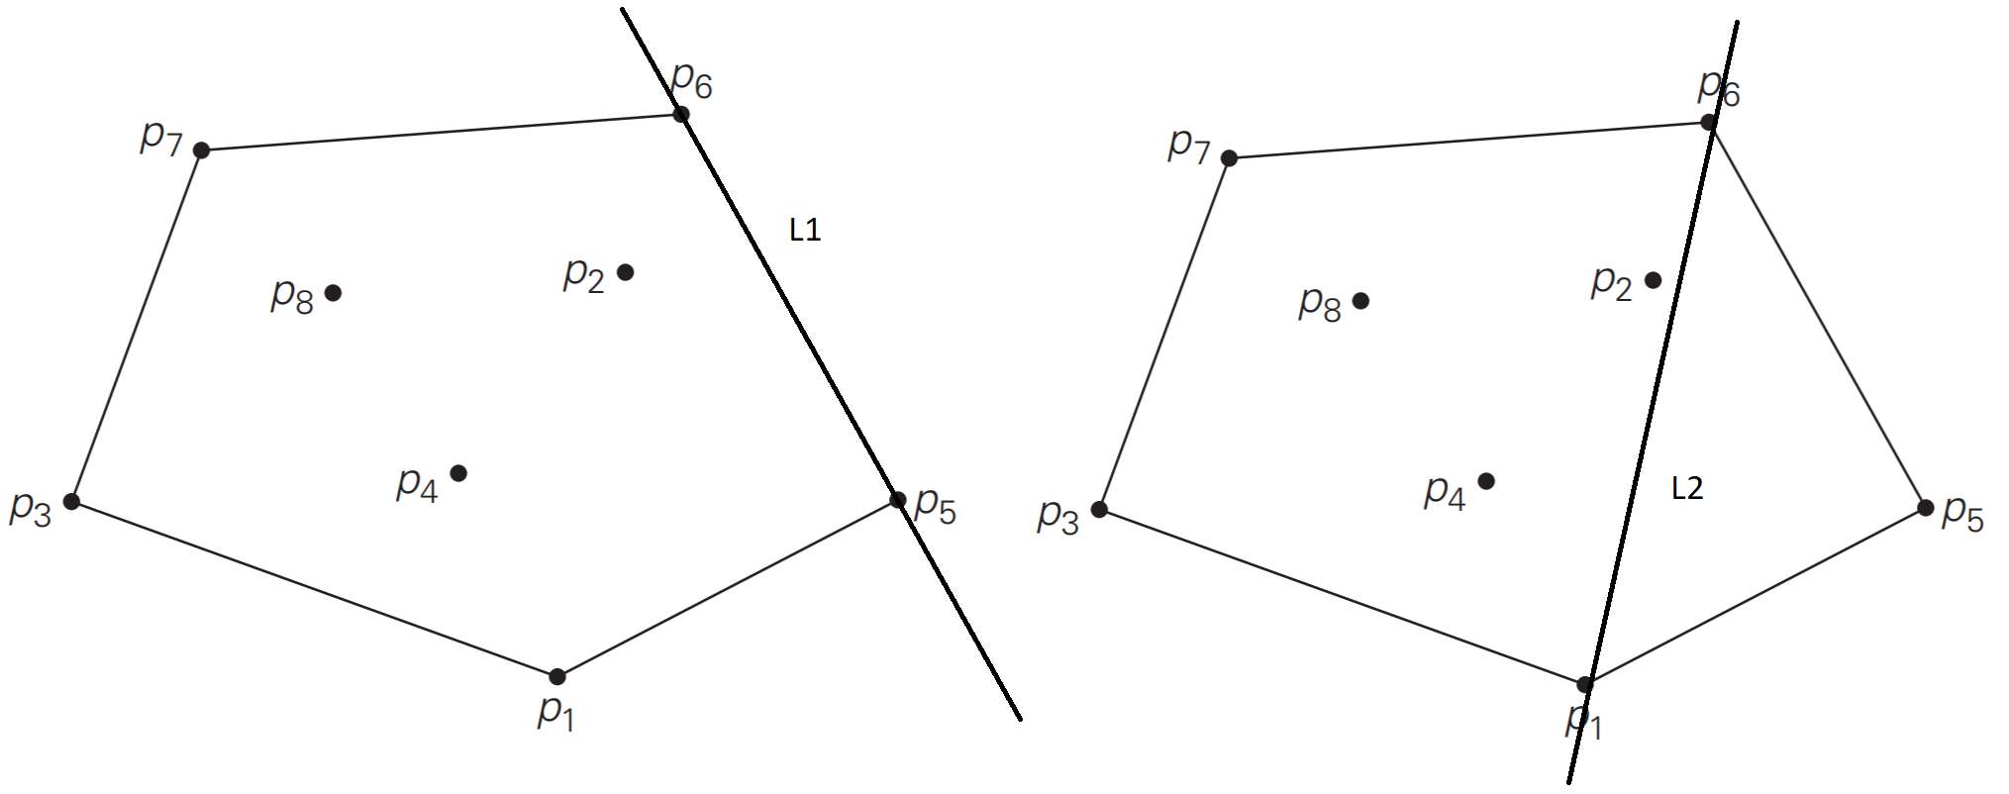
6.0 Convex Hull problem Contd.
Solving the convex hull problem using brute force.
A line segment connecting two points pj and pi of a set of n points is a part of the convex hull if and only if all other points lie on the same side of the straight line through these two points.
Repeating this test for every pair of points yields a list of line segments that make up the convex hull’s boundary.
L1 shows that all points are on the same side of the line connecting p6 and p5 and thus that line is a segment of the convex hull’s boundary
L2 shows that not all point are on the same side of the line connecting p6 and p1 and thus that line is not part of the convex hull’s boundary

Slide 16
7.0 Exhaustive search
Is a brute force approach to combinational problems.
Application:
Generate each and every element of the problem domain.
Select those who satisfy all of the constraints and then finding a desired element.
Examples of problems that exhaustive search can be applied to
The traveling salesman problem
The knapsack problem
Assignment problem

Slide 17
7.1 The Traveling salesman problem
The problem asks to find the shortest tour through a given set of n cities that visits each city exactly once before returning to city where it started.
The problem can be described in terms of edges and vertices.
Then the problem can be stated as the problem of finding the shortest Hamiltonian circuit of the graph.
The circuit begins and ends with the same vertex, and all other n-1 vertices are distinct.
If duplicate permutations are removed the number of permutations needed is ½(n-1)!

Slide 18
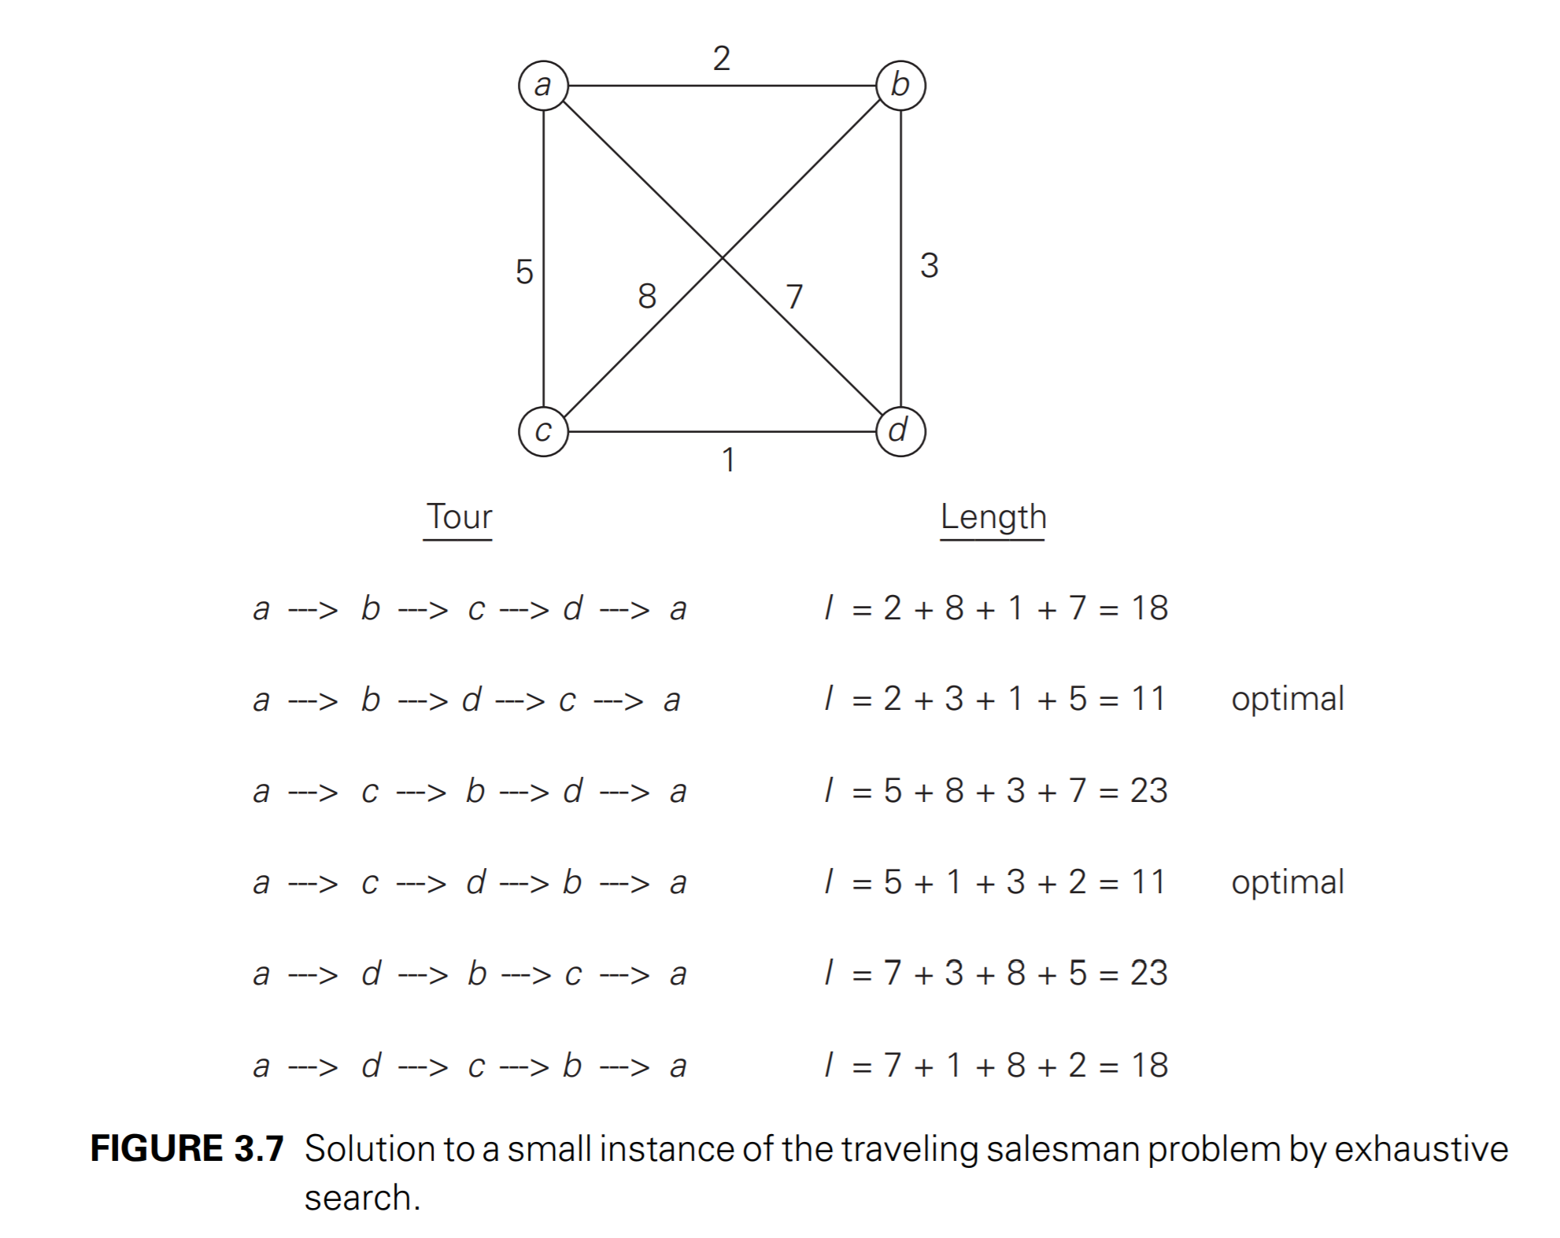
7.2 Example of Exhaustive Search on the TSM problem

Slide 19
8.0 The knapsack problem
Given n items of known weights, w1…wn, and values v1…vn, and a knapsack of capacity W, find the most valuable subset of the items that fit into the knapsack.
The exhaustive search approach to this problem leads to generating all possible subsets of size n items given, computing the total weight of each subset in order to find subsets that their total weight does not go over the knapsacks capacity, and finding the maximum value among them.
Since the number of subsets of an n-element set is 2^n, the exhaustive search leads to an Omega(2^n) algorithm, no matter how efficiently the subsets are generated.
Both TSM and the knapsack problems are NP-hard problems

Slide 20
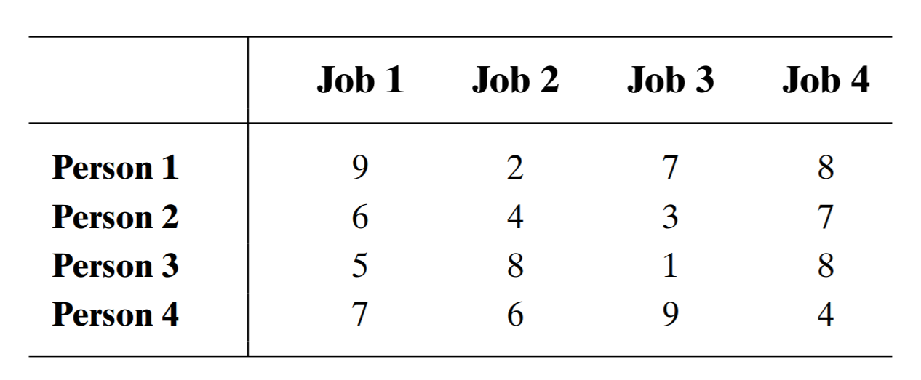
9.0 The assignment problem
There are n people who need to be assigned to execute n jobs, one person per job
The cost of person j doing job i is known
The problem is to find an assignment with the minimum total cost.

Slide 21
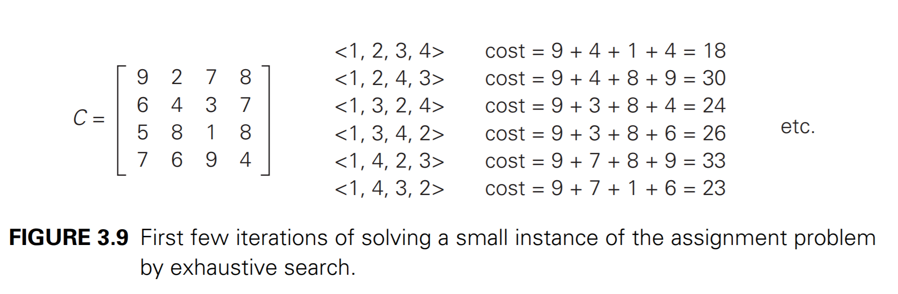
9.0 The assignment problem Contd.
Since the number of permutations to be considered for the general case of the assignment problem is n!, exhaustive search is impractical for all but small instances of n.
Better method: The Hungarian method

Slide 22
10.0 Depth-First Search and Breadth First Search
Considered as two very important algorithms that systematically process all vertices and edges of the graph.
Proved to be very useful for many applications involving graphs in Artificial Intelligence and Operations Research.
Indispensable for efficient investigation of fundamental properties of graphs such as connectivity and cycle presence.

Slide 23
10.1 Depth First Search Algorithm
Stats a graph’s traversal at an arbitrary vertex by making it as visited.
On each iteration, the algorithm proceeds to an unvisited vertex that is adjacent to the one it is currently in.
This process continues till dead end – a vertex with no adjacent unvisited vertices.
At the dead end, the algorithm backs up one edge to the vertex it came from and tries to continue visiting unvisited vertices from there.
The algorithm eventually halts after backing up to starting vertex, with the latter being the dead end.
By then, all vertices in same component have been visited – if unvisited vertices still remain then the search must be started in any of them.

Slide 24
10.1 Depth First Search Algorithm Contd.

Slide 25
10.1 Depth First Search Algorithm Contd.
Depth First Search Algorithm
//Implement a depth-first search traversal of a given graph
//Input: Graph G = V,E
//Output: Graph G with its vertices marked with consecutive integers
// in the order they are encountered by the DSF traversal
Mark each vertex in V with 0 as a mark of being “unvisited”
count <- 0
for each vertex v in V do
if v is marked with 0
dsf(v)
dsf(v)
//visits recursively all the unvisited vertices connected to vertex v
//by a path and numbers them in the order they are encountered
//via global variable count
count <- count +1; mark v with count
/for each vertex w in V adjacent to v do
if w is marked with 0
dsf(w)

Slide 26
10.2 Breadth First search Algorithm
It proceeds in a concentric manner by visiting first all the vertices that are adjacent to a starting vertex.
then all unvisited vertices two edges apart from it until all the vertices in the same connected component as the starting vertex are visited.
It is convenient to use queue to tracer the operations of breadth first search. The queue is initialized with the traversals starting vertex, which is marked as visited.
On each iteration, the algorithm identifies all unvisited vertices that are adjacent to front vertex, marks them visited, and adds them to queue.
After that, the front vertex is removed from queue.

Slide 27
10.2 Breadth First Search Algorithm Contd.

Slide 28
10.2 Breadth First Search Algorithm Contd.
Breadth First Search Algorithm
//Implements a breadth-first search traversal of a given graph //Input: Graph G = V,E
//Output: Graph G with its vertices marked with consecutive integers
//in the order they are visited by the BSF traversal
mark each vertex in V with 0 as a mark of being “unvisited”
count <- 0
for each vertex v in V do
if v is marked with 0
bsf(v)
bsf(v)
//visits all the unvisited vertices connected to vertex v
//by a path and numbers them in the order they are visited
//via global variable count
count <- count +1; mark v with count and initialize a queue with v
while the queue is not empty do
for each vertex w in V adjacent to the front vertex do
If w is marked with 0
count <- count +1; mark w with count
add w to the queue
remove the front vertex from the queue

